Slide 1


Leveraging Deep Learning for Multimodal Data Analysis in Credit Risk Assessment
Cristián Bravo
cbravoro@uwo.ca
@crbravor

Slide 2
Motivation
Think about how you make decisions! People make decisions holistically! Why wouldn’t our models do the same? Also, the best way to improve models is with better data.
Knowing which factors play a significant role in credit rating leads to better decision-making in financial applications.
The focus has been mostly on structured data and fewer studies have addressed unstructured or multi-modal datasets.
However multimodal is extremely common! Lending involves various data types.

Slide 3
Sources of Multimodality
Where can you find multimodality?
  Retail non-mortgage: Time series of behaviour, alternative data, social networks and correlated default.
  Mortgages: Satellite / Lidar, Street View, news, alternative data.
  Corporate: Financial statements, financial and supply chain networks, correlated default.
Regulatory changes may impact what we can do!
  Permanent minimum of 72.5% of Standard approach (have to hit it though!)
  US: pre-sold construction loans, statutory multifamily mortgages, and high-volatility commercial real estate (HVCRE) exposures, sovereigns and government bonds will be forced to use standard approach.
  EU: The European Banking Authority just published a new report on the use of AI for credit risk. https://tinyurl.com/mr3d2hta. The proposal does not forbid the use of methods, but it does force better explainability (no standard methods for this yet!), a significant uplift against simpler methods, analysis of model stability.

Slide 4
Challenges
New challenges when using multimodal data!
  Data collection.
  Ethics and legality.
  Information Fusion strategies.
  Model architectures.
  Training costs.
  Deployment / inference costs.
  Statistical gain.
  Economic usefulness.
  …
  Main question: Is multimodality worth it?

Slide 5
Examples in this Talk
Two areas (not affected by regulatory threats!)
  Single family mortgages.
  Midcap corporate companies.
Modalities:
  Numeric behaviour variables.
  Financial markets.
  Text from financial statements and news.
  LIDAR
  Standard scorecard variables

Slide 6

First Example: Multimodal Deep Learning for Midcaps
Co-authors: Kamesh korangi, mahsa Tavakoli, rohitesh Chandra, christophe mues

Slide 7
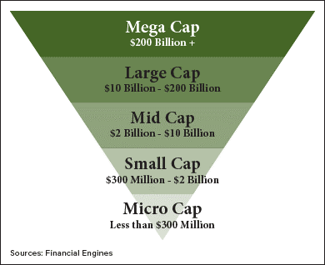
Mid-caps
Mid-cap companies are publicly traded companies with less than US$10 billion market capitalisation
Their debt has a shorter maturity period than large-caps
Typically hold a non-investment grade credit rating, implying higher credit risk
Lots of disaggregated information, more dependent on general economic conditions.

Slide 8

Research questions
Which combination of fusion types/order-strategy and deep learning models lead to better performance for credit rating prediction?
What is the contribution of each modality separately and which channel plays the most important role?

Slide 9
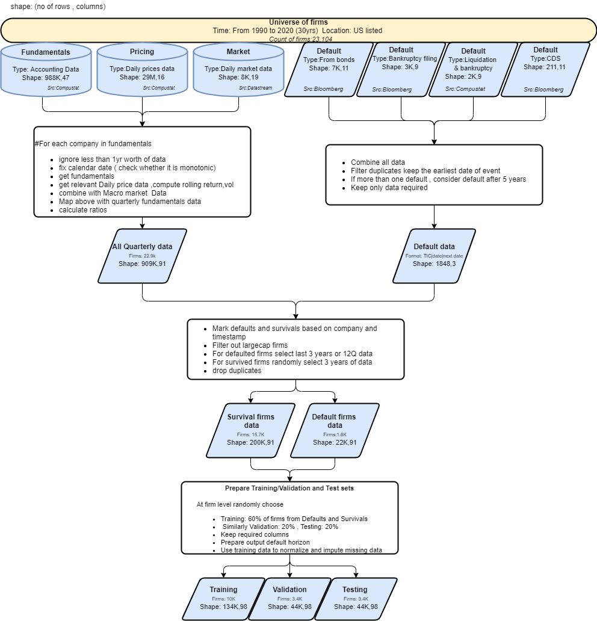
Data description
30 years of data related to mid-cap companies listed in the US from 1990 to 2020
Three different data sources
Wider definition of default

Slide 10
Text: Earning call transcript
Doc1− ... In global components, sales declined 2% year-over-year as double-digit growth in Asia was offset by revenue declines in the Americas and Europe, reflecting the broad macroeconomic trends in those regions. Adjusted for the impact of acquisitions and changes in foreign currency, sales in global components were down 3% year-over-year...
Doc2− ... We operate a segment-driven business model across the globe. So, if you think about banking priority and gold, that common segment-driven business model and our approach to operating the model with the right cost to serve characteristics by segment is common across the globe ...
Doc3− ... As compared to the prior year’s third quarter, the gross profit rate increase was primarily attributable to higher initial inventory mark-ups and lower inventory shrink, partially offsetting these items were a greater proportion of sales of consumables,...

Slide 11
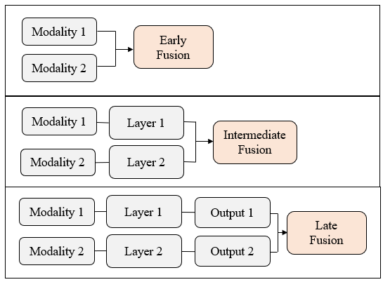
Challenge: Fusion Level
Signal/Data/Early level fusion combines the raw data directly, which preserves as much information as possible.
A higher-level fusion is feature-level fusion, in which the features and characteristics, instead of the raw data, are fused to generate outputs as refined characteristics.

Slide 12
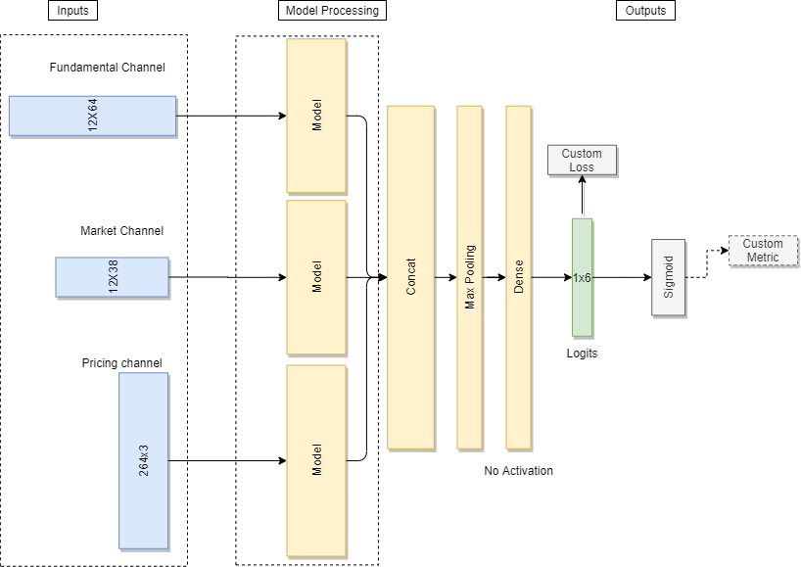
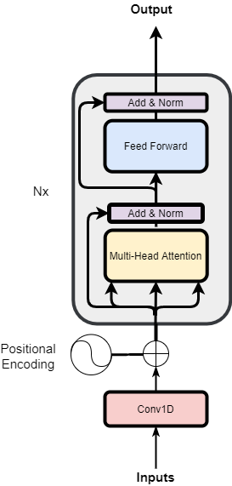
Model architecture – Only Time Series
Transformer Encoder model
Multi-modal architecture

Slide 13
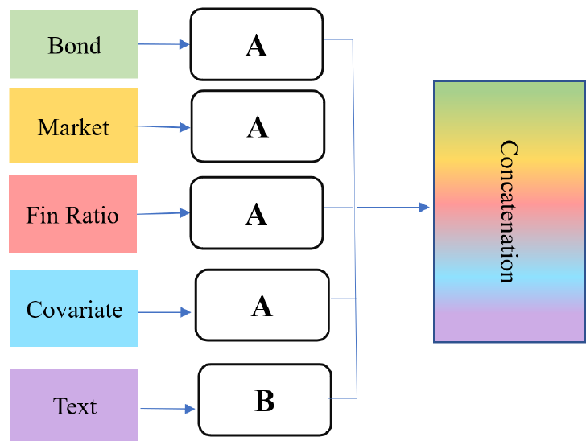
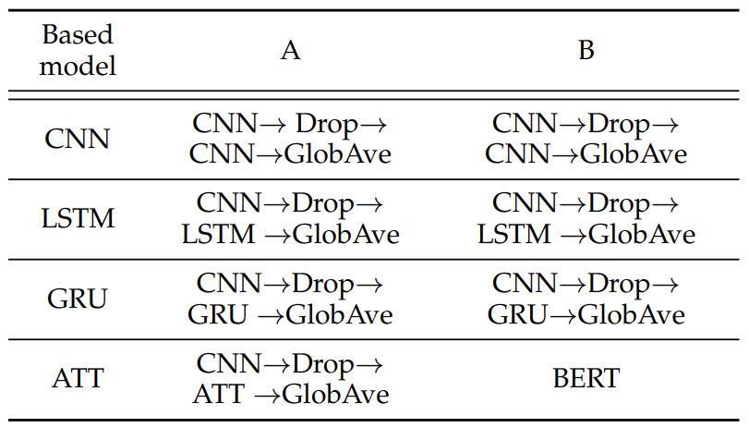
Model Architecture: Adding Financial Statements
Group 1 (Benchmark): Simple concatenation

Slide 14
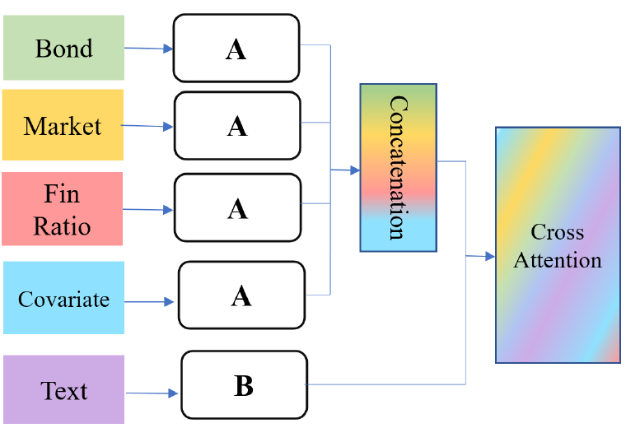
Model Architecture: Adding Financial Statements
Group 2: Attentive concatenation

Slide 15
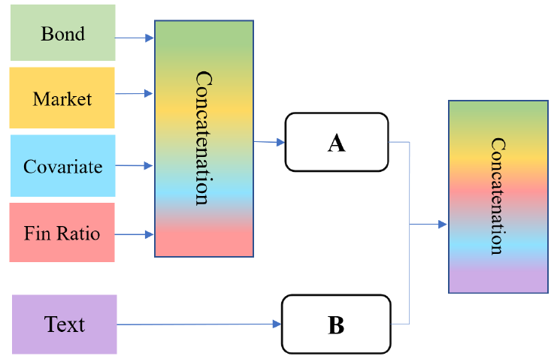
Model Architecture: Adding Financial Statements
Group 3: Hybrid concatenation

Slide 16
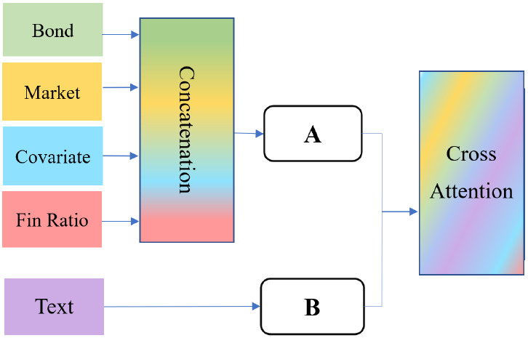
Model Architecture: Adding Financial Statements
Group 4: Hybrid attentive concatenation

Slide 17
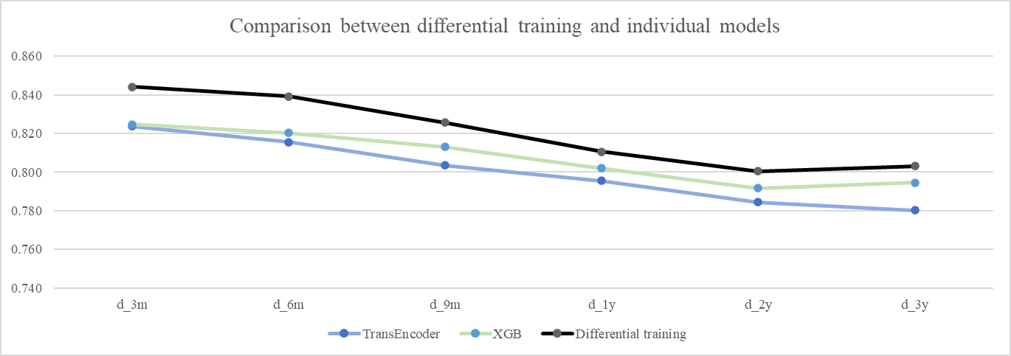
Results: Only time series
Deep learning models perform better with individual data
Long-range dependencies could be found with TransEncoder and TCN as can be seen from daily pricing data channel
With all data, multi-modal architecture allows deep learning models to outperform XGB

Slide 18
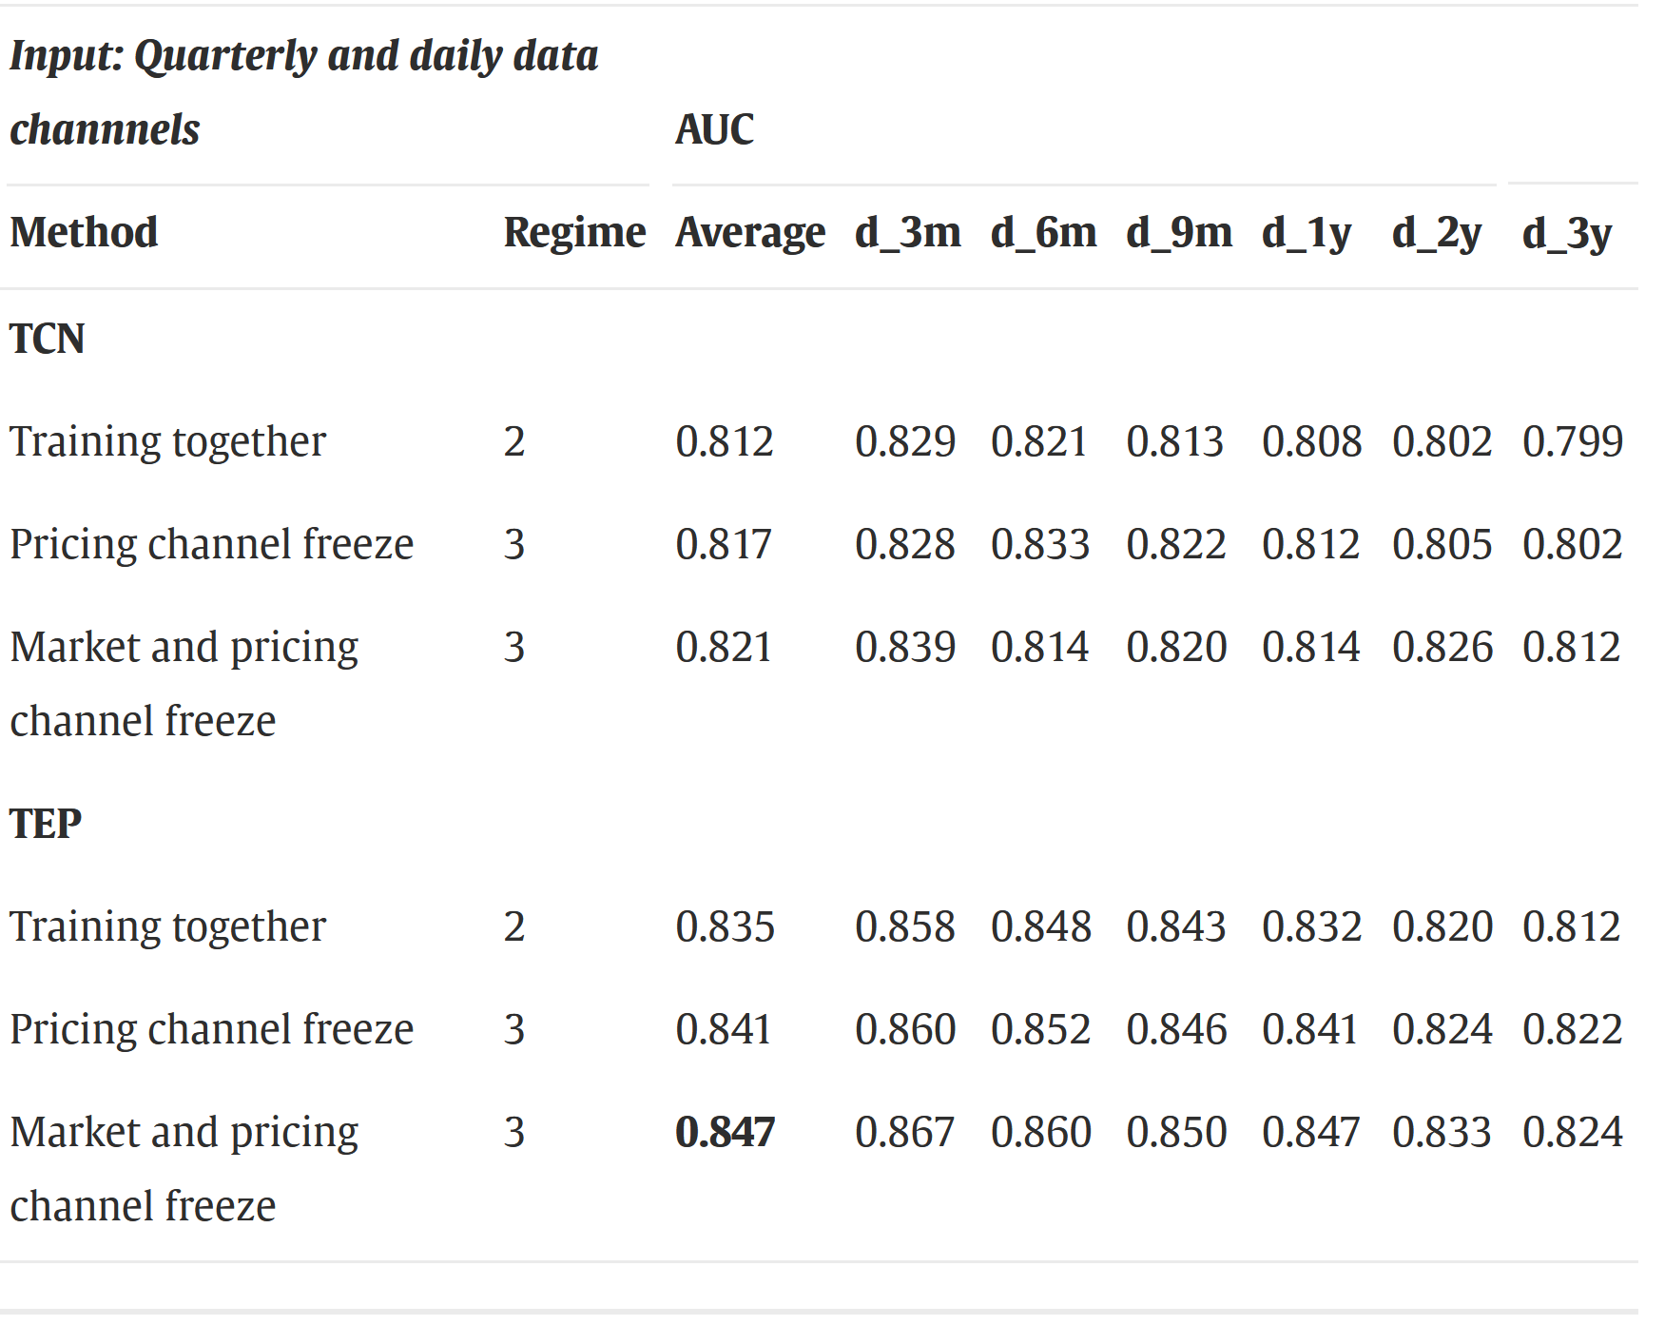

Slide 19
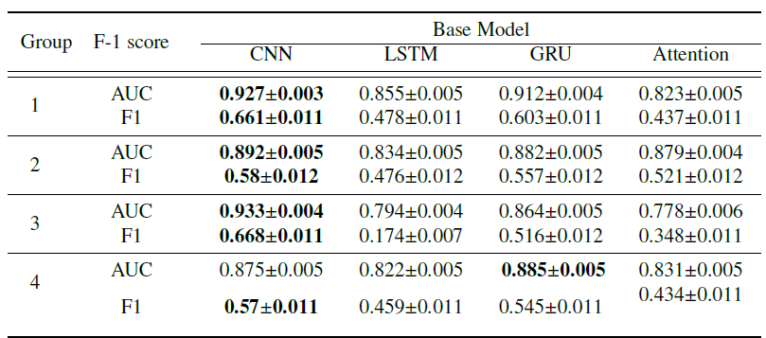
Results: Multimodal Model
The performance of the transformer-based model as a state-of-art is not the best one.
- Need for high-token model?
Attention models require cross-attention fusion!
Cross-attention fusion makes models behave more similarly.
Excellent performance of multimodal model when trained correctly!!

Slide 20

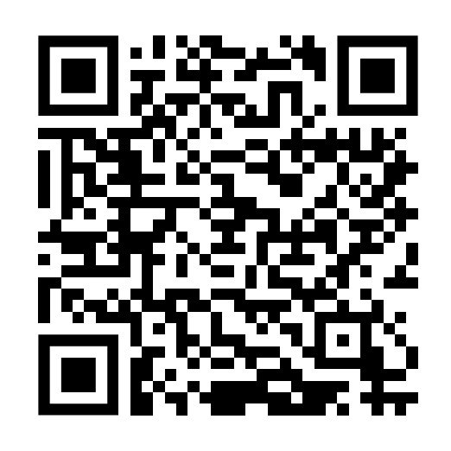
Papers!
Time series: Korangi et al. (2023) @ EJOR
Multimodality: Tavakoli et al. (2023) preprint

Slide 21
Second Example: Multimodal Deep Learning for Mortgages
Co-authors: Kamesh korangi, mahsa Tavakoli, sahab Zandi, rohitesh Chandra, christophe mues, maria Óskarsdóttir

Slide 22

Social Network Data: Dataset
We use the Single-Family Loan-Level (SFLL) dataset provided by the Federal Home Loan Mortgage Corporation (FHLMC), commonly known as Freddie Mac, that focuses on mortgage lending in the USA.
Freddie Mac purchases mortgages on the secondary market, pools them, and sells them as a mortgage-backed security to investors on the open market.
Goal: Default prediction!

Slide 23
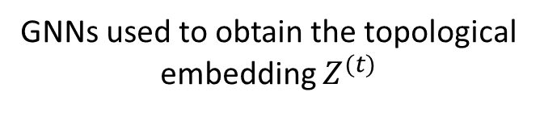
Methods (cont’d)
Topological embedding
Graph Convolutional Networks (GCN)
GNNs used to obtain the topological embedding $Z^{(t)}$
Graph Attention Networks (GAT)

Slide 24
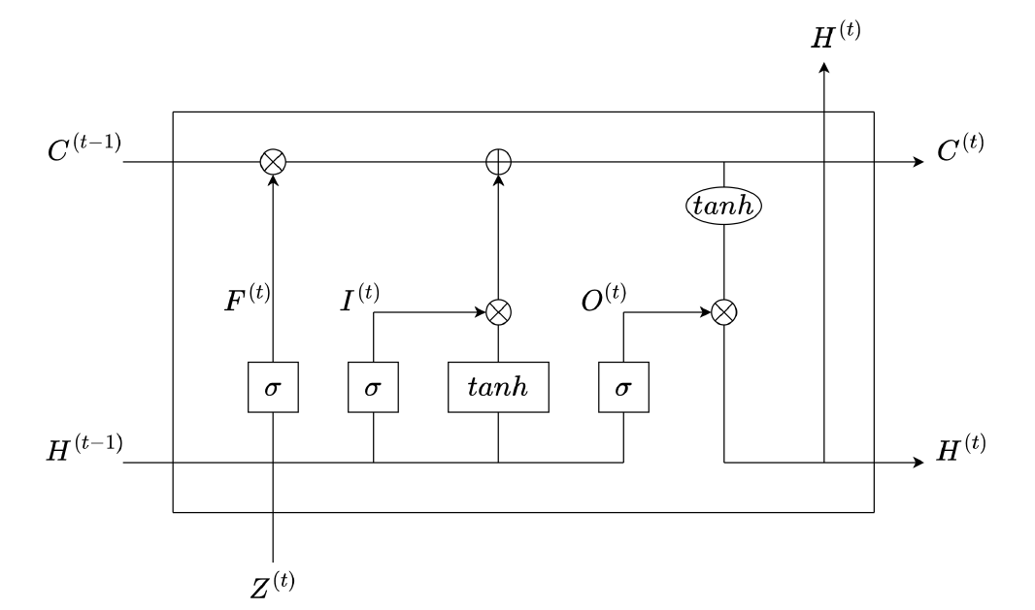
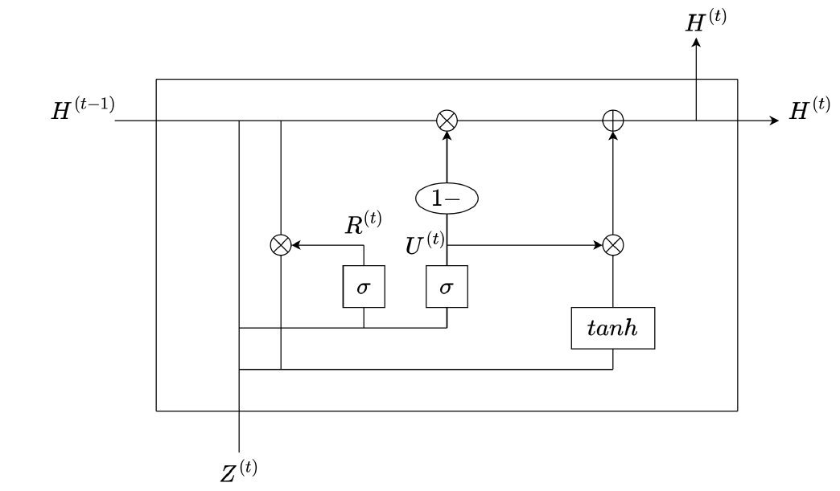
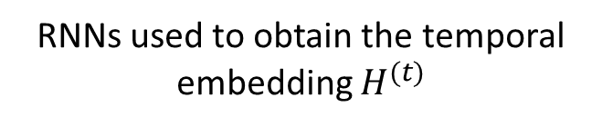
Methods (cont’d)
Temporal embedding
Long Short-Term Memory (LSTM)
RNNs used to obtain the temporal embedding $H^{(t)}$
Gated Recurrent Unit (GRU)

Slide 25
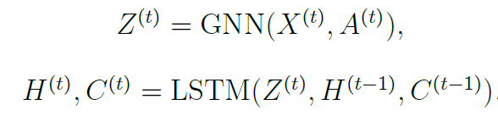
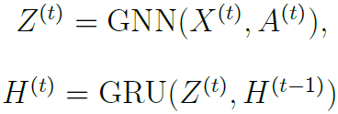
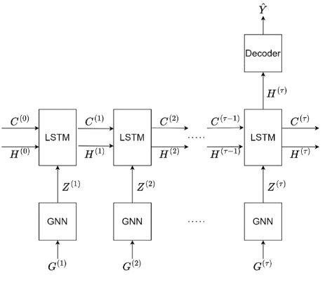
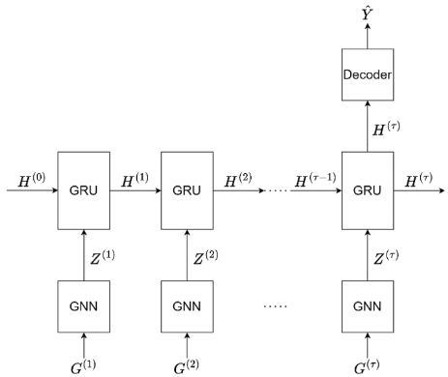
Methods (cont’d)
GNN-RNN models
GNN-LSTM
GNN-GRU

Slide 26
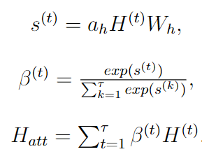
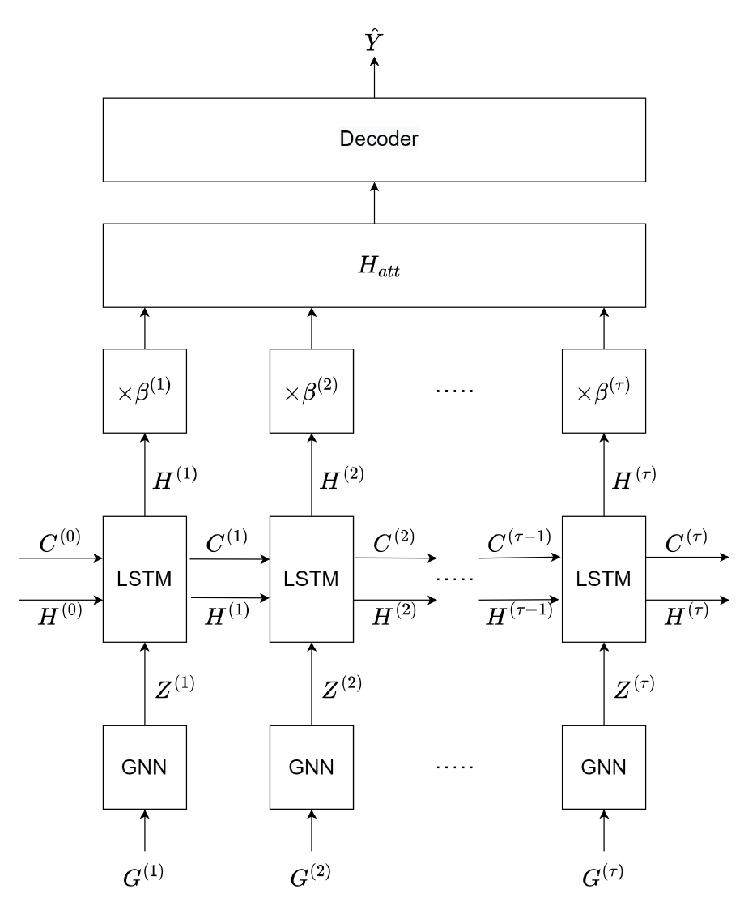
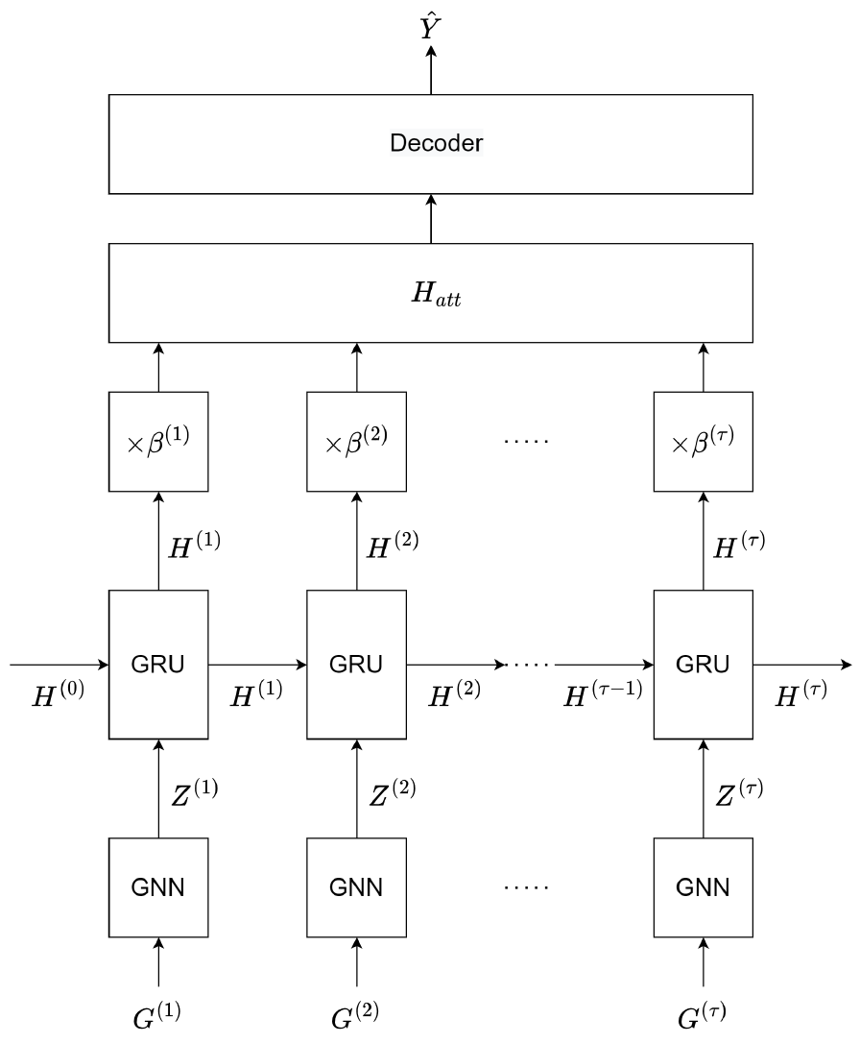
Methods (cont’d)
GNN-RNN-ATT models
GNN-LSTM-ATT
GNN-GRU-ATT

Slide 27

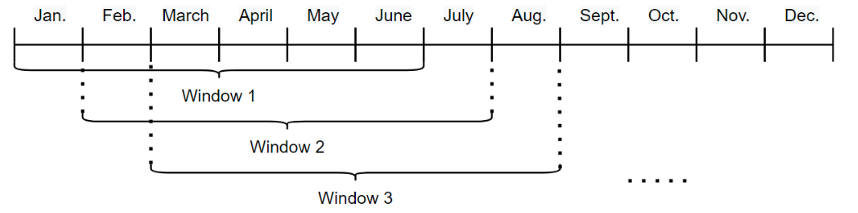
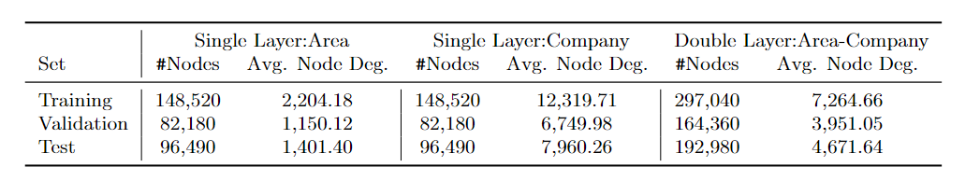
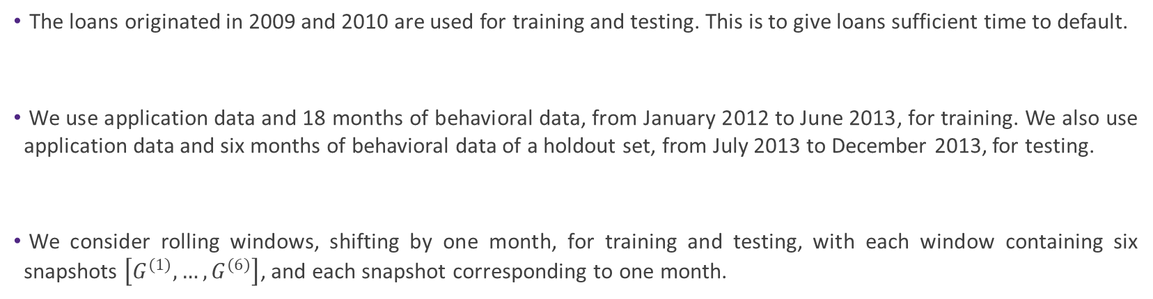
Dataset
Dynamic networks
The loans originated in 2009 and 2010 are used for training and testing. This is to give loans sufficient time to default.
We use application data and 18 months of behavioral data, from January 2012 to June 2013, for training. We also use application data and six months of behavioral data of a holdout set, from July 2013 to December 2013, for testing.
We consider rolling windows, shifting by one month, for training and testing, with each window containing six snapshots $\left[G^{(1)}, …, G^{(6)}\right]$, and each snapshot corresponding to one month.

Slide 28
Dataset (cont’d)
All snapshots of a specific window have the same set of nodes. However, node set could be different from one window to another.
During training each window, the goal is to predict default within 12 months after the month of the last snapshot of that window.
We apply a specific dropout technique on graph structures to increase the expressiveness of the model. We randomly select and isolate 50% of the nodes in each snapshot of a window.
We can train the models using both single layer and double layer networks with geographical location and lending company of the borrowers being the connector variables.

Slide 29
Dataset (cont’d)
Data features
Feature | Description
fico | Credit score at the time of acquisition
if_fthb | Is the borrower a first-time home buyer?
mi_pct | Mortgage insurance percentage
cnt_units | Number of units in the property
if_prim_res | Is the property a primary residence?
dti | Original debt to income ratio
ltv | Original loan to value ratio
if_corr | Is a correspondent involved in the origination of the mortgage?
if_sf | Is the property a single family home?
if_purc | Is the mortgage loan a purchase mortgage?
cnt_borr | Number of borrowers obligated to repay the mortgage
if_sc | Does the mortgage exceed conforming loan limit?
current_upb | Current unpaid principal balance
if_delq_sts | Is there any arrear in the payment?
mths_remng | Number of months remaining
current_int_rt | Current interest rate

Slide 30
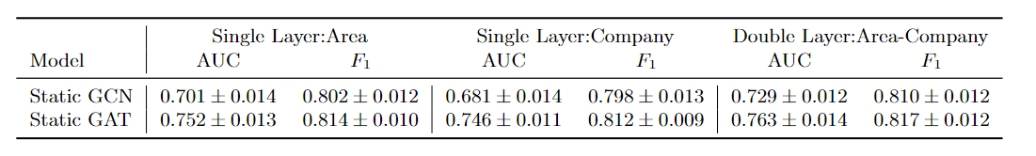
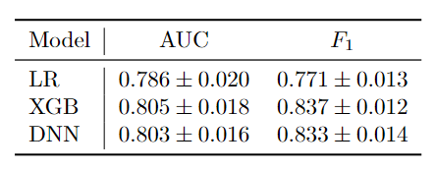
Results
Baseline models
GNN-based baselines
Non-GNN-based baselines

Slide 31
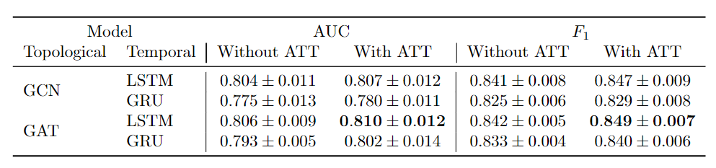
Results (cont’d)
Single layer network – Geographical Area

Slide 32
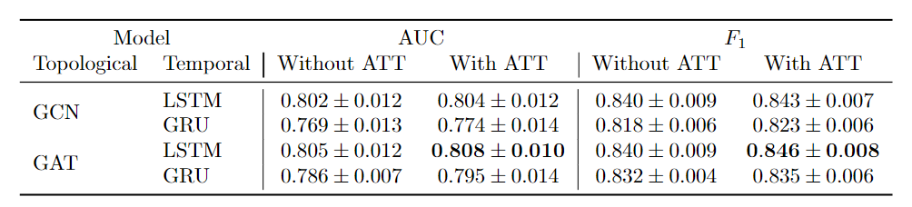
Results (cont’d)
Single layer network – Lending Company

Slide 33
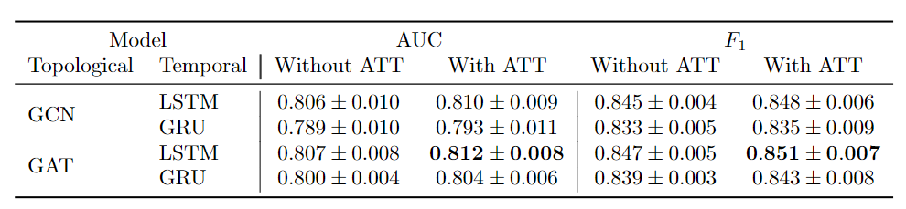
Results (cont’d)
Double layer network – Geographical Area & Lending Company

Slide 34
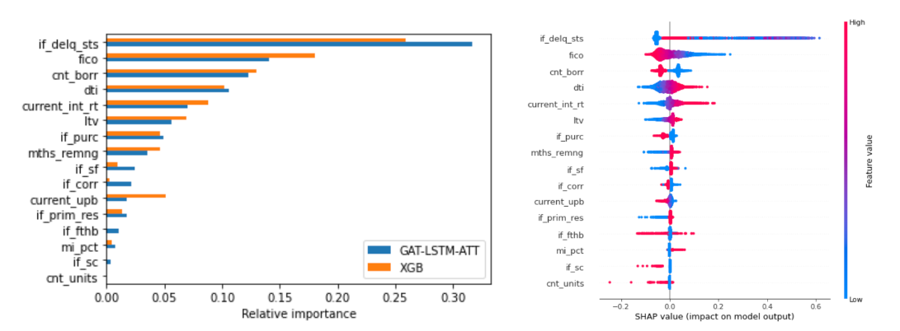
Results: Variable Importance
Importance of node features

Slide 35
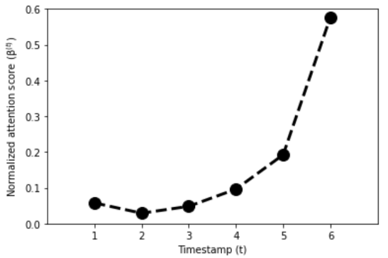
Results (cont’d)
Importance of timestamps

Slide 36
Second Example: Multimodal Model on Netherlands Residential Mortgage
Data Source: European Data Warehouse https://editor.eurodw.eu
Time-Neutral Analysis
Dataset Selection: At the beginning of the period, all mortgages' statuses are performing.
Analysis After Almost 3 Years:
  Performing or Repurchased (Low Risk)
  Arrears or Default (High Risk)
Three modalities: Images from LiDAR, Text from news and sentiment analysis from statements

Slide 37
Text Modality:
Exploring News Content and Mortgage Risk
Focused Extraction from Seeking Alpha website https://seekingalpha.com/market-news
Specific Keywords Relevant to Mortgage Risk:
Netherlands, Interest Rate, Mortgage, Housing Market, Unemployment, European Policy
Interest Rate Fluctuations:
Low Rates: The greater inclination to approve high-risk mortgages.
High Rates: Exercise greater caution.
Housing Market Changes:
Booming Market: Perceived lower risk in approving high-risk mortgages.
Declining Market: Hesitancy due to potential defaults and losses.
Unemployment Rate:
High Unemployment: Higher risk of defaults, cautious lending.
European Policies:
Regulations and Criteria for Mortgage Lending.
Stricter policies discourage riskier lending practices.
Country-Specific Impact: "Netherlands" Keyword
Investigate the influence of general country-specific news on mortgage risk in the Netherlands.

Slide 38
Image Channels: Utilizing LiDAR Data
Data Source: Earth Engine data catalogue:
https://developers.google.com/earth-engine/datasets/catalog/AHN_AHN2_05M_RUW
Incorporating AHN Netherlands 0.5m DEM (Digital Elevation Model) Raw Samples
  High-resolution representation of the Netherlands terrain generated from LiDAR data
  Includes ground-level samples and above-ground objects (buildings, bridges, trees)
Generating the DEM: Detailed Elevation Information
Point cloud converted into a 0.5m grid using squared inverse distance weighting method.

Slide 39
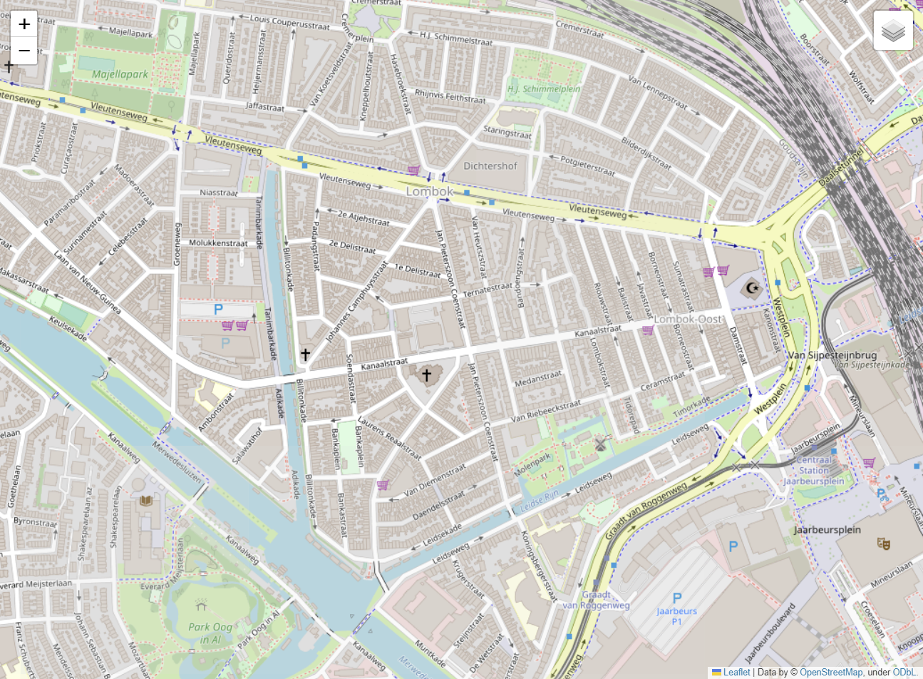
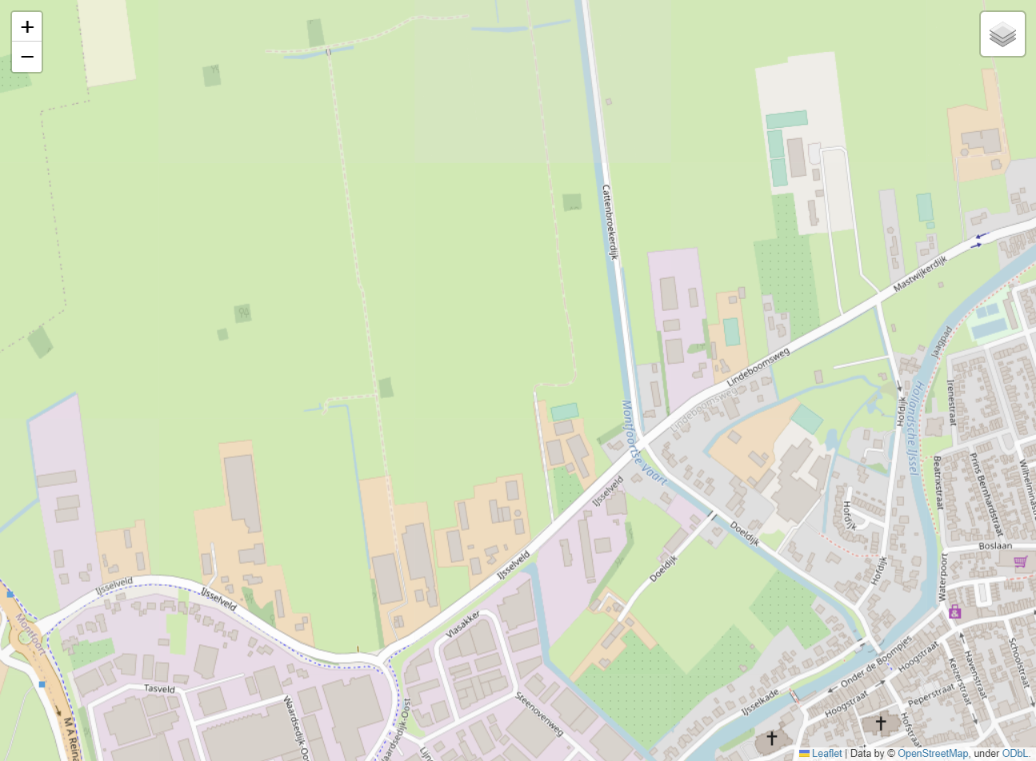
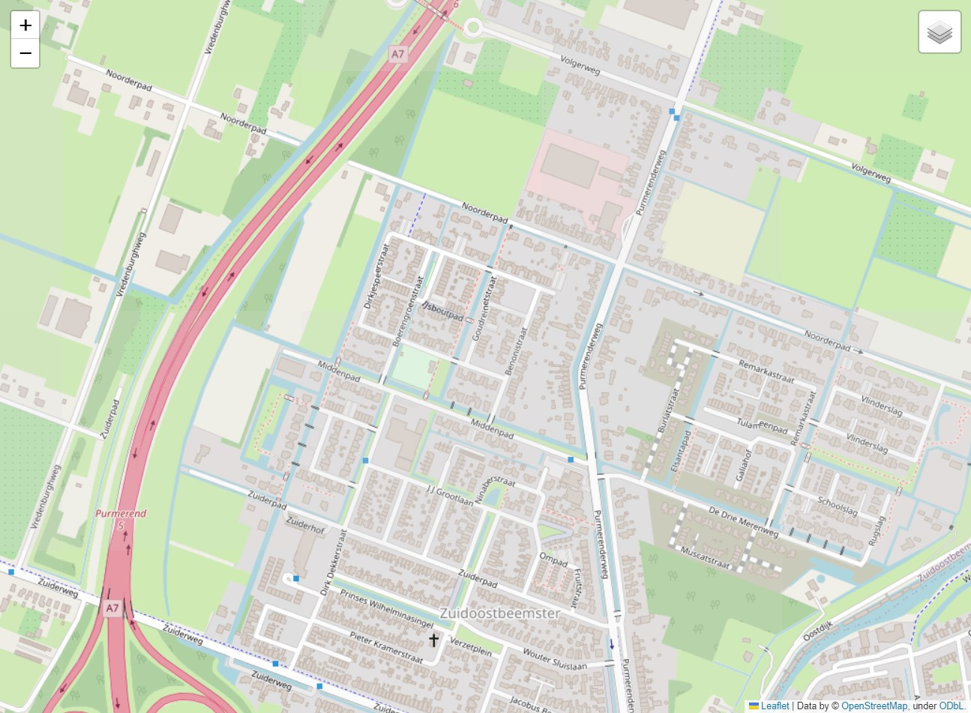
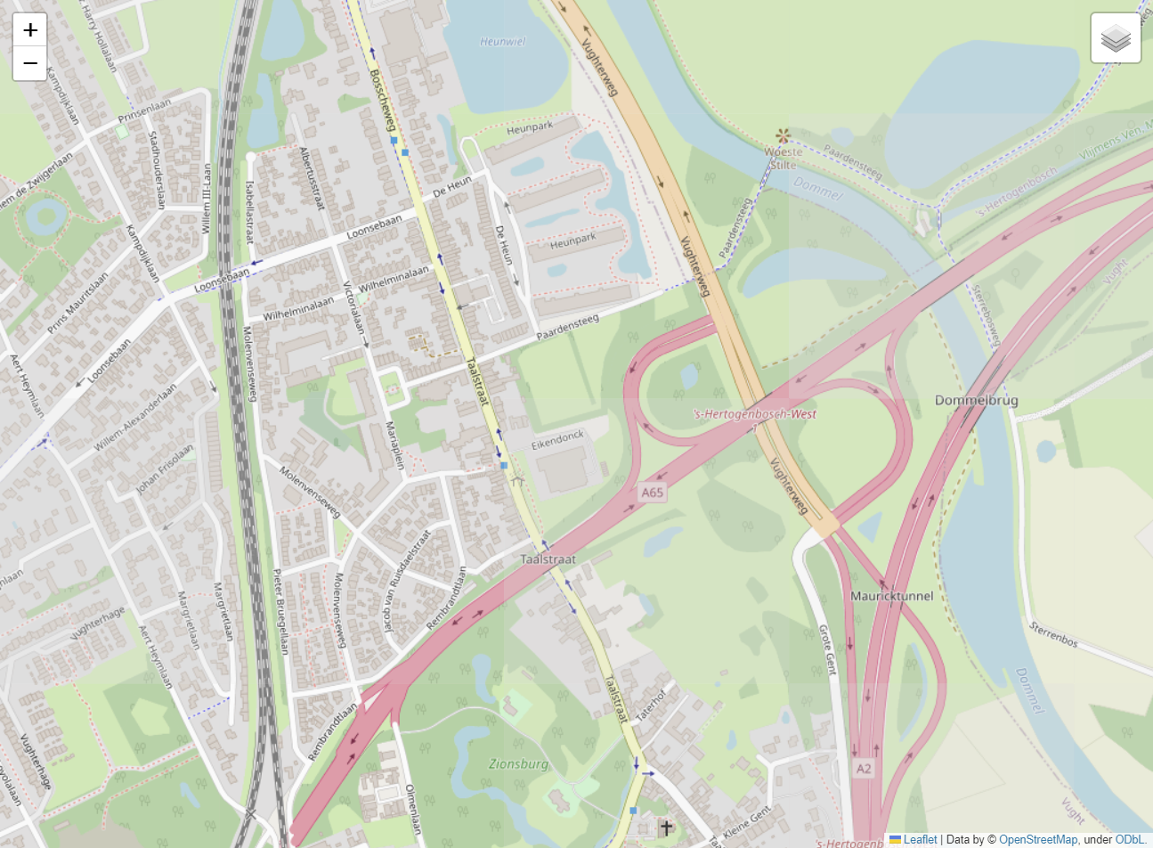
LiDAR Map Samples

Slide 40
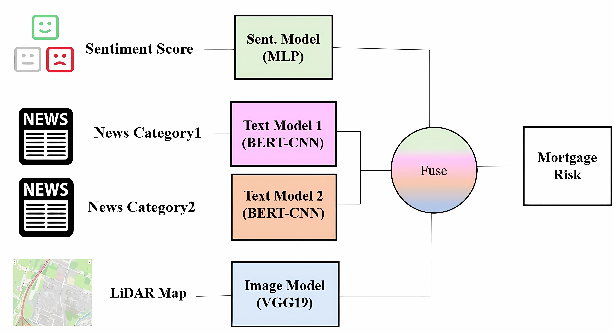
Multimodal Model Architecture

Slide 41
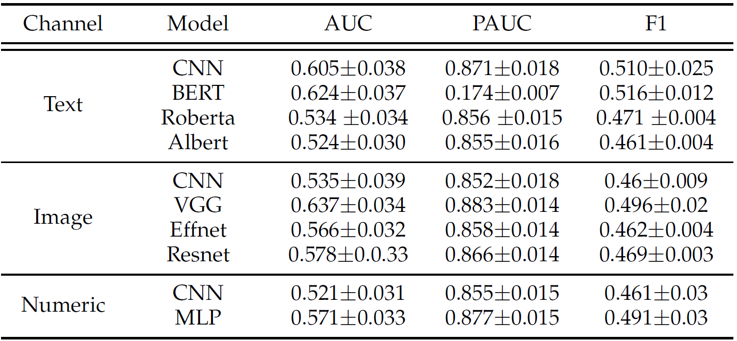
Unimodal Benchmarks

Slide 42
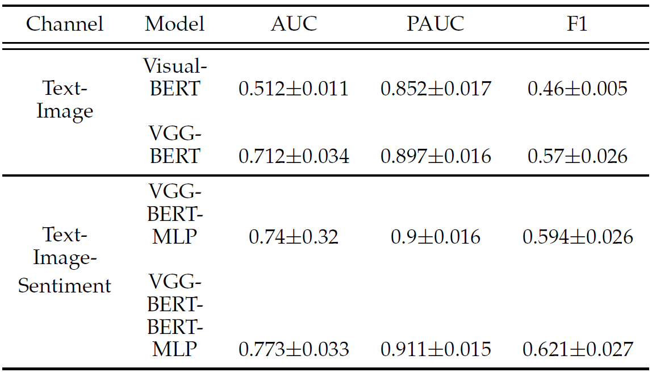
Multimodal Models

Slide 43
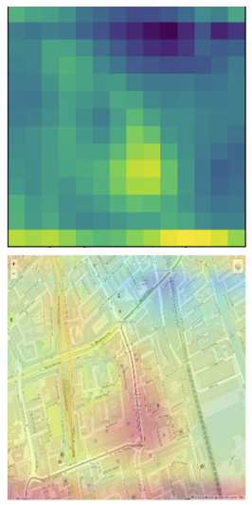
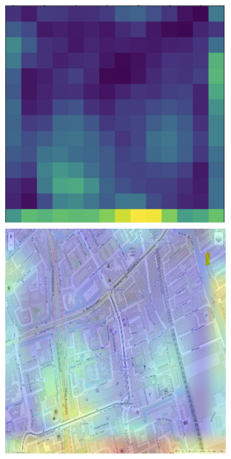
GradCAM Heatmap Analysis
VGG model (image input only) shows distinct colour variations.
Multi-model approach considers additional information like news and sentiment, introducing complexity that potentially dilutes the impact of visual features.
VGG model
(Image input only)
Multi-model (Image- Text- Sentiment)

Slide 44
Conclusions

Slide 45
Conclusions
USE MULTIMODALITY IF YOU HAVE IT
How to overcome challenges:
  Upon data collections: Check your data lakes. What data is at the bottom?
    Think about data ethics at this stage! Do not include data you don’t know how to use at this stage.
  Upon architecture design: Think about fusion strategies. Add attention when necessary!
    If using attention, fuse with attention.
  Upon training: Use differential training.
  Upon validation: Investigate contribution of each channel and use visualization and backtracing methods to understand how the data is contributing.
    Not always the most complex model is the best.
    Validate both in profit terms and in statistical terms.
Potential gains are significant! Worth it if your portfolios are large.

Slide 46







Thank you!
Q&A
With thanks to

Slide 47
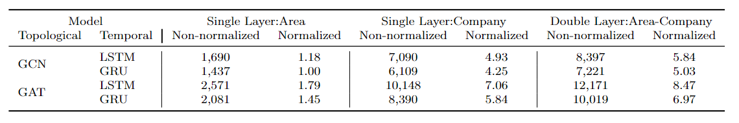
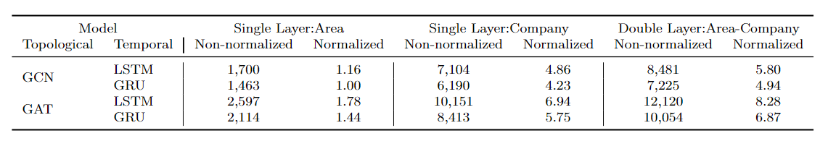
Mortgage Multilayer: Runtime
GNN-RNN models (seconds)
GNN-RNN-ATT models (seconds)

Slide 48
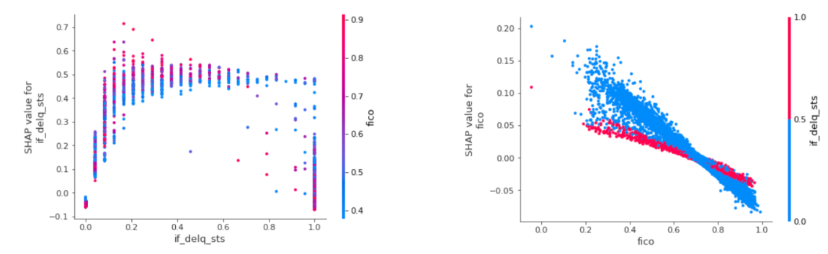
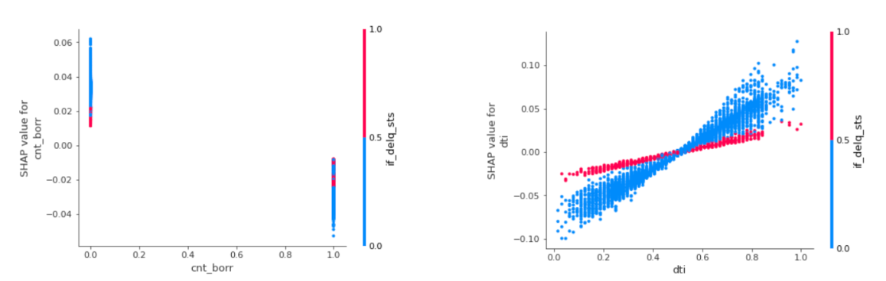
Results: Dependency plots

